Slide 1
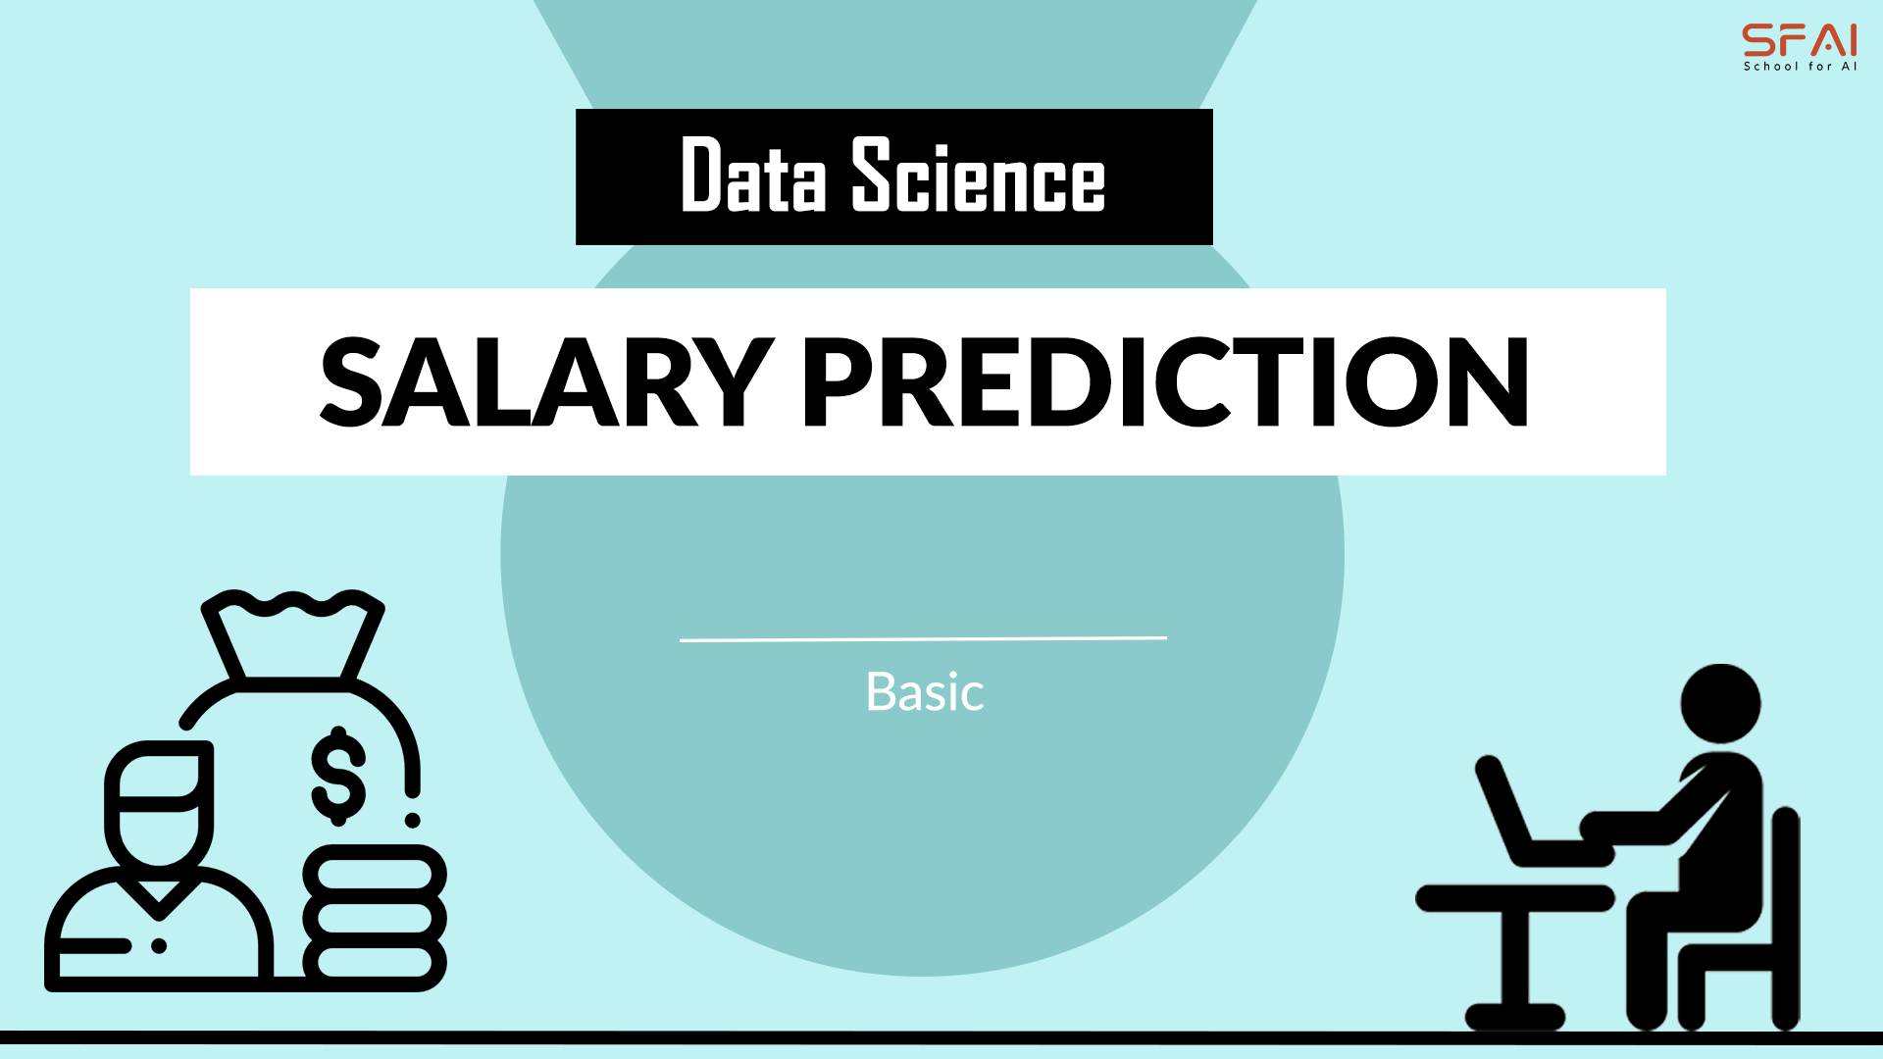
SALARY PREDICTION
SUBMITTED BY :ANUSHKA KALRA

Slide 2
Introduction
In today's dynamic job market, predicting salaries accurately plays a pivotal role in various aspects of workforce management, recruitment, and financial planning. The ability to estimate salaries based on a range of factors empowers organizations to make informed decisions regarding budget allocation, employee compensation, and talent acquisition strategies. Therefore, the development of robust salary prediction models has become increasingly valuable in modern business operations.
The goal of our project is to construct a reliable salary prediction system that leverages machine learning techniques to forecast salaries for individuals based on relevant attributes such as Job Titles, experience, skills, and Job Posting location. By analyzing historical salary data and identifying patterns within the job market, our aim is to create a model capable of providing accurate salary estimates for new job listings or assessing the competitiveness of compensation packages offered by employers.
Through this project, we seek to address several key challenges in salary prediction, including the inherent variability in compensation across industries, regions, and job roles, as well as the complex interplay of factors influencing salary determination.
By applying advanced machine learning algorithms and feature engineering techniques to large-scale datasets, we aim to develop a predictive model that not only achieves high accuracy but also provides insights into the factors driving salary disparities and trends within the job market.

Slide 3
Problem Statement:
In Today’s competitive job market, accurately predicting salaries for job positions is essential for organizations to make informed decision regarding budget allocation, compensation strategies, and talent acquisition.
Employee Satisfaction: Contribution to Job satisfaction by establishing fair and transparent compensation practices, fostering trust and loyalty among employees.
The primary challenge we aim to address with our salary prediction project is the accurate estimation of salaries for individuals based on a diverse set of attributes, including but not limited to education level, years of experience, specialized skills, industry sector, and geographic location. Additionally, we seek to account for the complex interactions between these factors and their impact on salary levels across different job roles and industries.
Furthermore, the availability and quality of data for salary prediction can vary significantly, posing challenges in terms of data preprocessing, feature selection, and model generalization.
By developing a robust salary prediction model, our objective is to address these challenges and provide stakeholders with a reliable tool for estimating salaries with a high degree of accuracy and precision.
In summary, our salary prediction project seeks to bridge the gap between employer expectations and candidate aspirations by leveraging machine learning techniques to provide transparent and data-driven salary estimations, thereby facilitating more equitable and informed decision-making in the realm of human resource management.

Slide 4
Research Objectives:
1. Analyze Historical Salary Trends: Examine past salary data to identify trends and patterns over time that can inform future predictions.
2. Evaluate the Impact of Educational Background: Study how different levels and types of education influence salary outcomes across various industries and job roles.
3. Examine the Role of Geographic Location: Investigate how location impacts salary, considering factors such as cost of living, local job markets, and regional industry concentrations.
4. Assess the Influence of Experience and Skills: Determine how years of experience and specific skill sets affect salary levels, and identify which skills are most highly compensated in different fields.
5. Integrate Socio-Economic Factors: Explore how socio-economic factors such as gender, race, and socio-economic background influence salary outcomes.
6. Predict Salary Growth Potential: Develop models to predict an individual's potential salary growth over time based on various personal and professional factors.
7. Benchmark Against Industry Standards: Compare predicted salaries with industry standards to ensure competitiveness and fairness in compensation packages.
8. Analyze the Impact of Company Size and Sector: Study how company size and the sector in which it operates affect salary levels and growth.

Slide 5
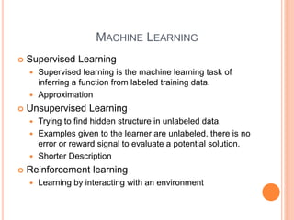

Slide 6
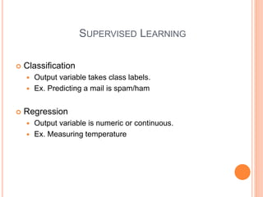

Slide 7
About Dataset
The “Jobs_NYC_Postings” is a real-world dataset generated and provided by New York city for the purpose of exploring salary prediction task contains simulated data reflecting various influencing salary levels such as Job Title, education, experience, Salary Range, Agency and Posting Type, Work location. Dataset can be used for predictive modeling tasks to estimate salaries based on these factors.
Dataset Name: “Jobs_NYC_Postings.csv”
Dataset Fields:
Job Titles
Experience
Salary Range [From – To]
Agency and Posting Type
Work Location

Slide 8
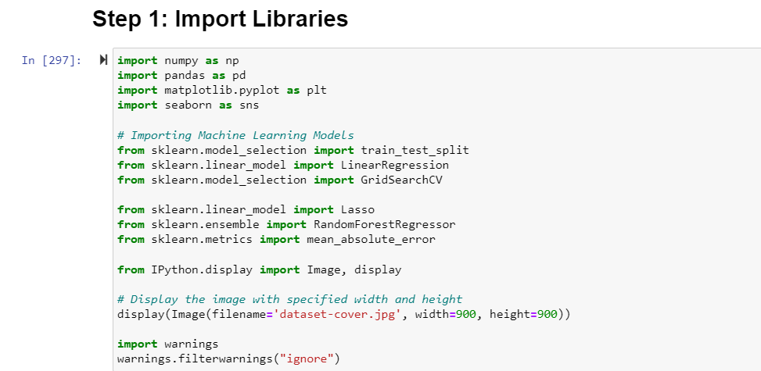
Initial Steps for Data exploring
Data Collection
Salary Prediction Data, Predicting the salary according to the features
Explore, Clean and prepare dataset
Importing Libraries:
Importing NumPy and pandas
Matplotlib.pylot for visualization
Seaborn visualization library
Scikit-learn [sklearn] is used python library for Machine Learning.
Ipython.display for importing image.
Import warnings used for handle warnings.

Slide 9
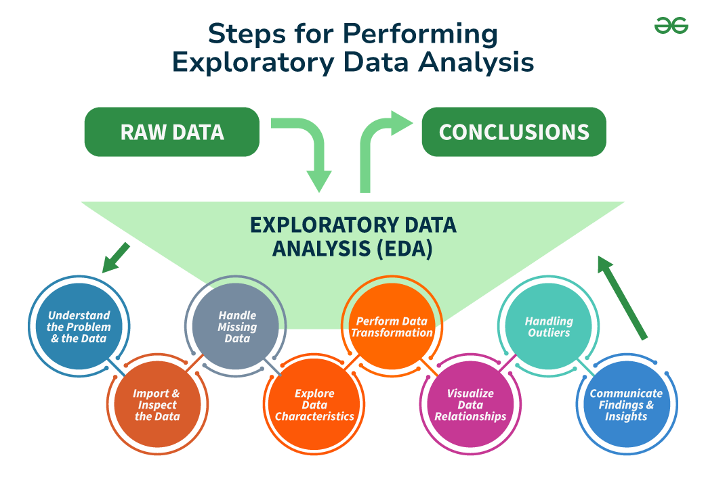
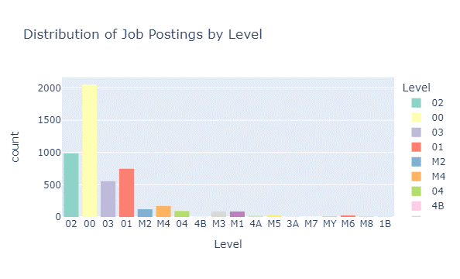
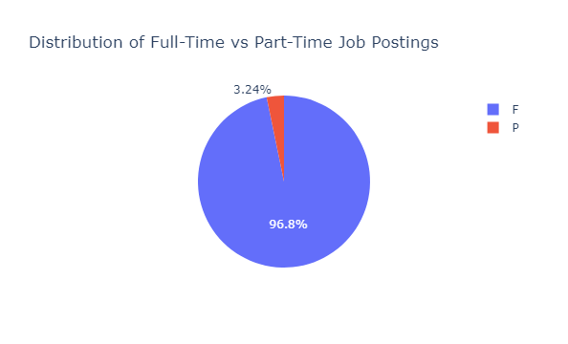
Exploratory Data Analysis (EDA)
EDA Process for Salary Range Prediction
Data Inspection: Reviewed dataset features such as job ID, number of positions, salary ranges, and agency details.
Handling Missing Values: Identified and resolved missing data for completeness.
Categorical Encoding: Converted categorical variables (e.g., agency, job title) to numerical using one-hot encoding.
Distribution Analysis: Analyzed numerical feature distributions to understand their spread.
Correlation Analysis: Explored feature relationships to identify salary predictors.
Visualization: Used histograms, box plots, and scatter plots to identify patterns and trends.

Slide 10
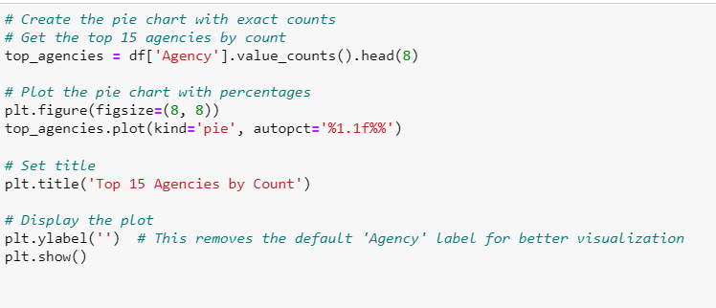
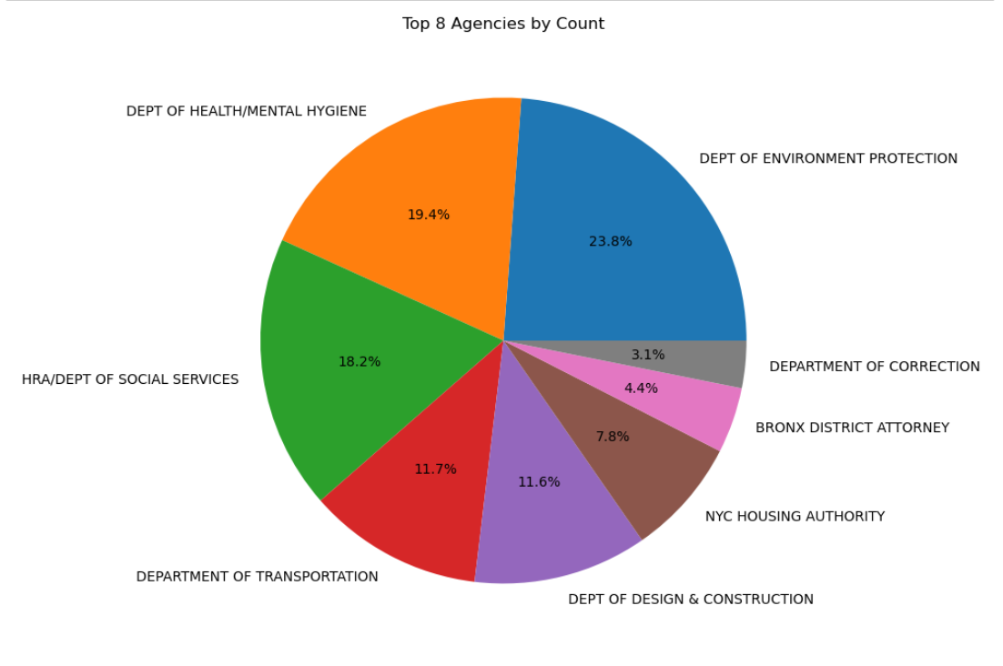
The DEPT OF ENVIRONMENT PROTECTION has the highest count at 23.8%, followed by the DEPT OF HEALTH/MENTAL HYGIENE at 19.4% and HRA/DEPT OF SOCIAL SERVICES at 18.2%. The lowest count is for the DEPARTMENT OF CORRECTION at 3.1%.
Conclusion: The DEPT OF ENVIRONMENT PROTECTION leads in count, indicating it may have a higher number of employees or projects compared to other agencies.

Slide 11
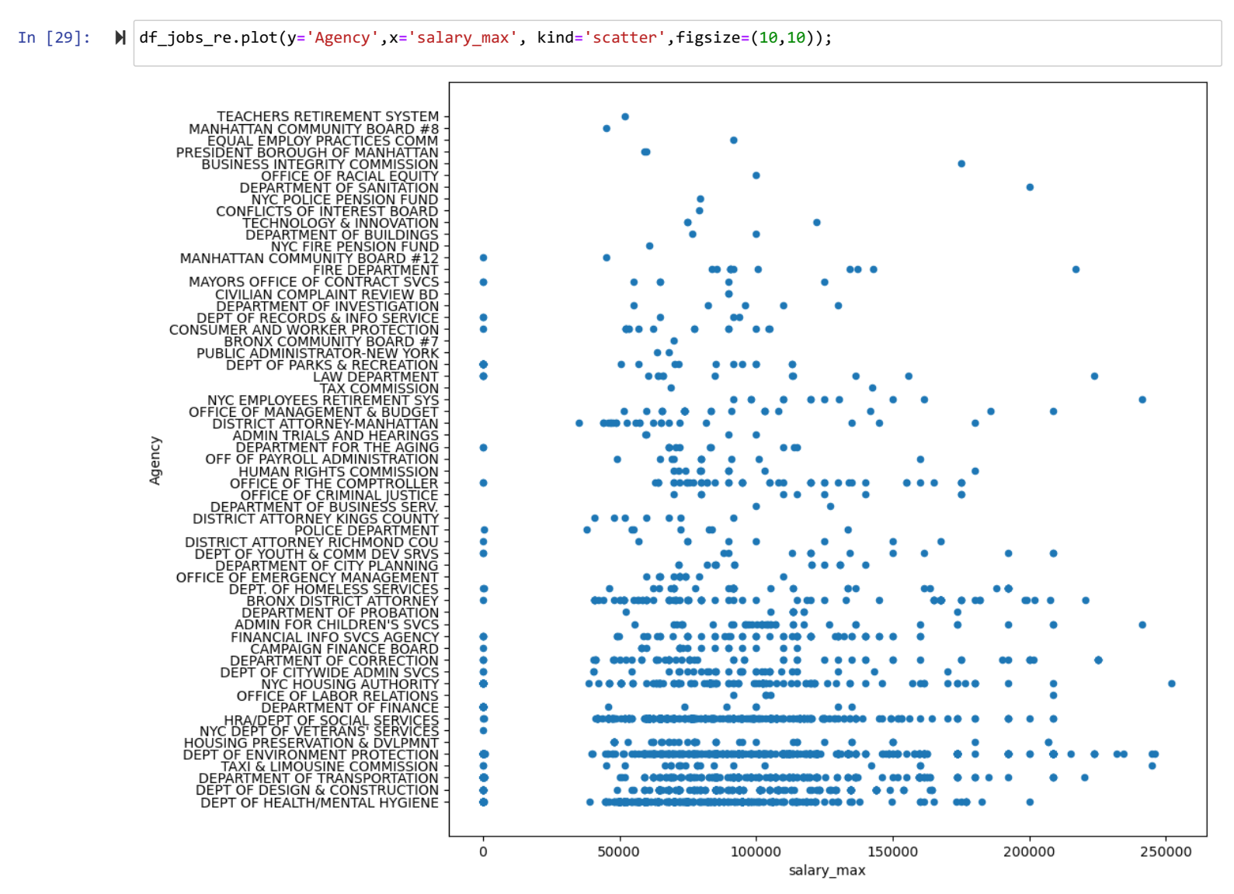
Insights:
Salary Range Distribution:
The maximum salary (salary_max) values range from close to 0 up to about 250,000.
There is a noticeable concentration of job positions with maximum salaries between 50,000 and 150,000. This indicates that most job postings fall within this salary range.
Agency-Specific Salary Trends:
Department of Health/Mental Hygiene, Department of Design & Construction, and Department of Transportation appear to have a wide range of maximum salaries, extending from lower salary ranges up to higher ones.
Some agencies like TEACHERS RETIREMENT SYSTEM and MANHATTAN COMMUNITY BOARD #8 have fewer data points, indicating they may have fewer job postings in the dataset or a more limited salary range.
High-Salary Agencies:
Agencies like NYC HOUSING AUTHORITY and DEPARTMENT OF TRANSPORTATION have job postings that reach the higher end of the salary spectrum (above 150,000).
High salary points are more sporadically distributed across fewer agencies, indicating specialized or high-level positions in those departments.
Low-Salary Agencies:
Many agencies have maximum salaries clustered around the lower end of the scale (below 50,000), suggesting these agencies may offer more entry-level or lower-paying positions.
Density of Job Listings:
Agencies such as DEPARTMENT OF HEALTH/MENTAL HYGIENE and DEPT OF DESIGN & CONSTRUCTION have a higher density of job listings across a broad range of salaries. This could indicate a large number of diverse roles within these departments.
Exploring the relationship between the maximum salary (salary_max) and the different agencies.

Slide 12
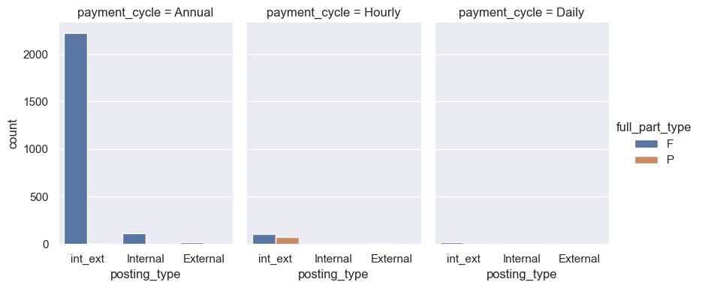
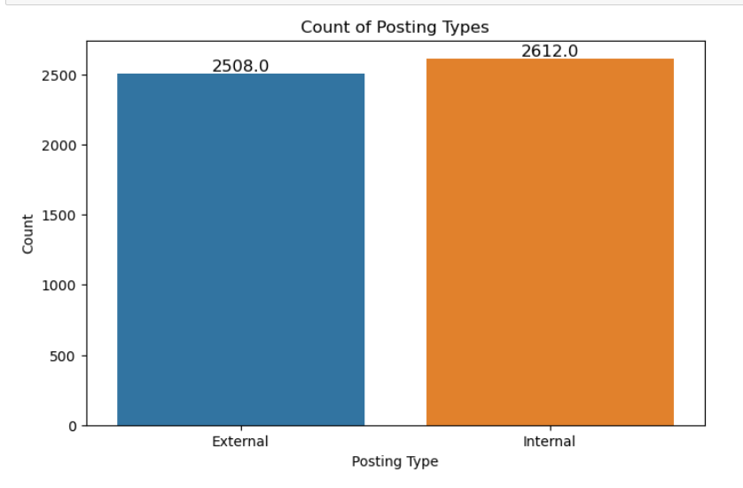
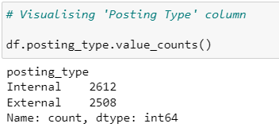
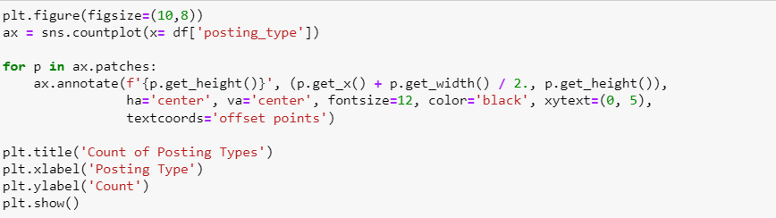
Visualizing “Posting Type”
Here’s the “Posting Type” value count.
'External' reaches up to 2508 on the y-axis. This indicates there are 2508 job postings categorized as external.
‘Internal’ reaches up to 2612 on the y-axis. This indicate there are 2612 job postings categorized as internal.
Organization implications: If the organization tends to promote from within or promoting internal hiring, which leads them higher internal posting count. Understanding this distribution can help HR departments in workforce planning, ensuring adequate internal opportunities to keep current employees engaged while also bringing in new external talent. Analyzing trends over
Part time jobs are only in the hourly cycle of the postings

Slide 13
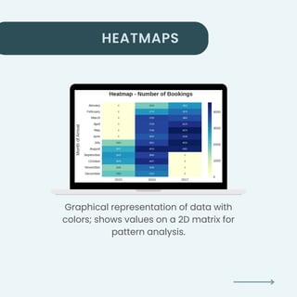
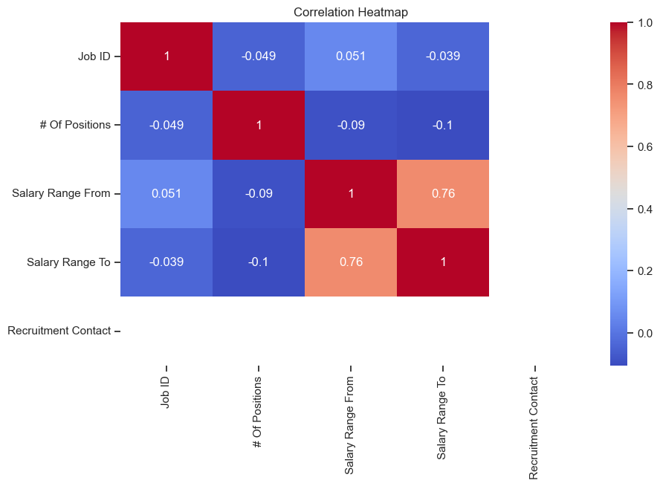
A heatmap is generated to visualize the correlation matrix of the entire dataset providing the comprehensive overview of relationship between numerical variables.
Insights:
Salary Correlation:
Salary Range From and Salary Range To:
The correlation coefficient between Salary Range From and Salary Range To is 0.76, indicating a strong positive correlation. This means that job listings with higher minimum salaries (Salary Range From) also tend to have higher maximum salaries (Salary Range To).
Number of Positions:
# Of Positions and Salary Range From/Salary Range To:
The correlation coefficients between # Of Positions and both Salary Range From (-0.09) and Salary Range To (-0.1) are relatively low and negative. This suggests that the number of positions does not have a strong relationship with the salary ranges, and if there is any relationship, it is weak and slightly inverse.
Job ID:
Job ID and other variables:
The correlations of Job ID with # Of Positions, Salary Range From, and Salary Range To are very low (-0.049, 0.051, -0.039 respectively). This indicates that Job ID is essentially an identifier and does not have a meaningful correlation with these numeric variables.

Slide 14
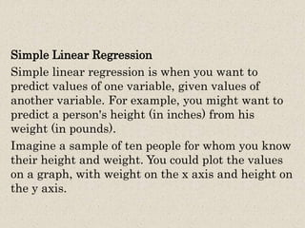
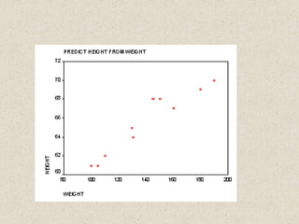

Slide 15
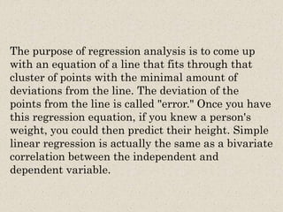

Slide 16

TRAIN AND TEST SPLIT
TRAIN TEST SPLIT We divided the data into training (80%) and testing (20%) sets.
Setting a random state ensures consistent results and using stratify=y maintains a proportional distribution of the target variable in both sets.
SPLITING THE DATA INTO X & Y
We divided the dataset into two parts: X and y.
"X" typically represents the independent Variables, and "y" represents the Dependent (target variable) that we want to predict or understand.

Slide 17
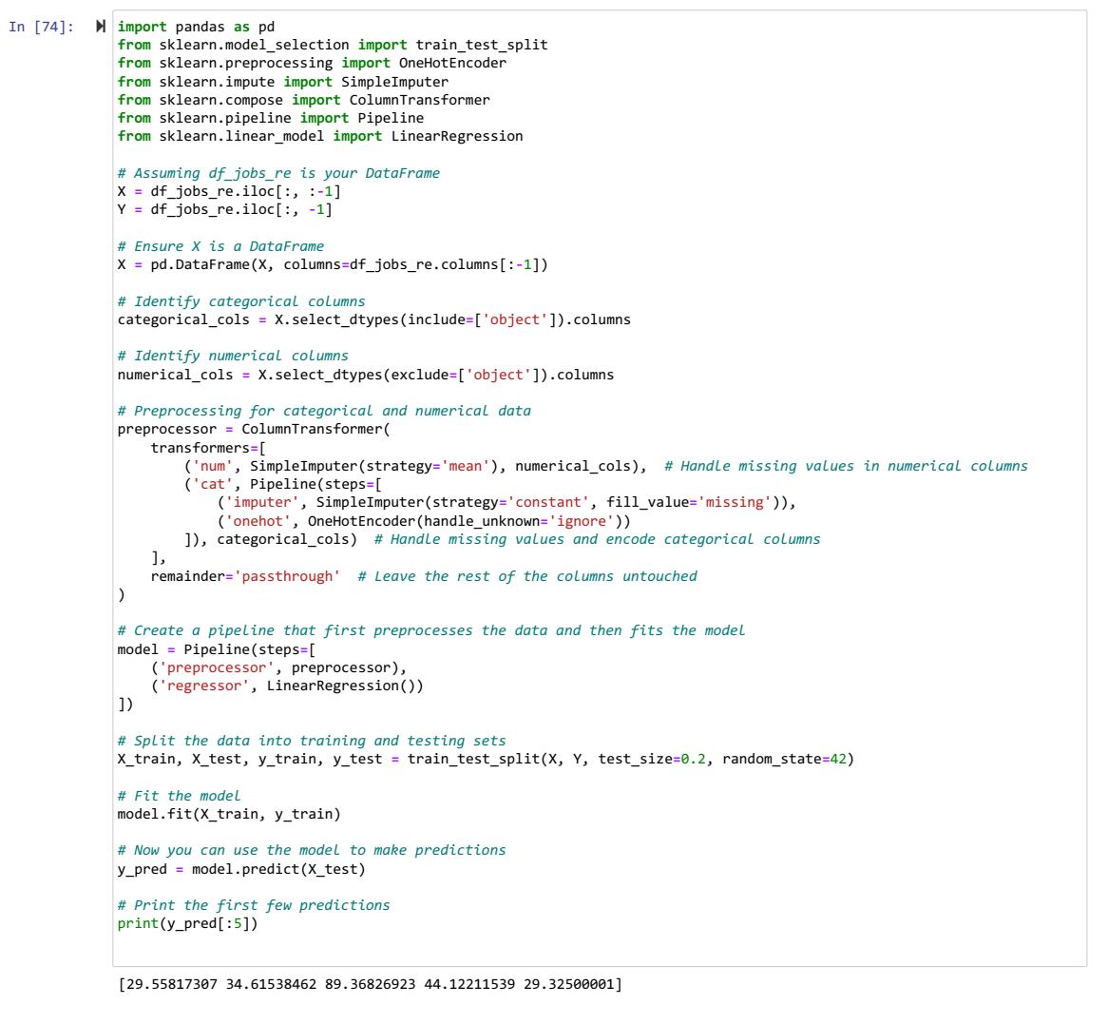

Slide 18
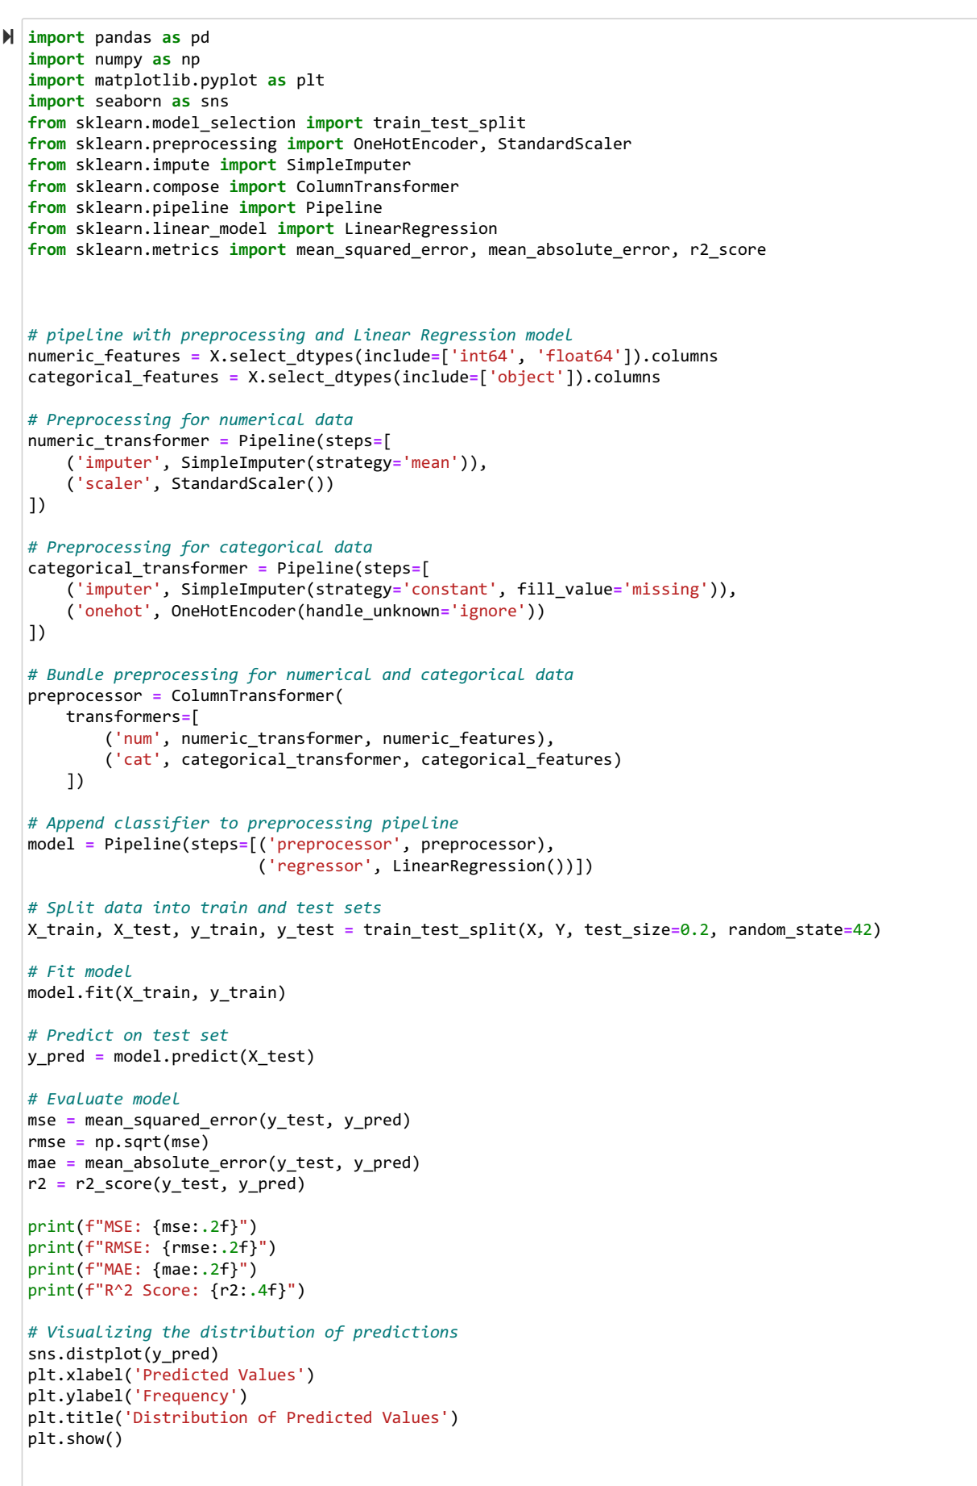
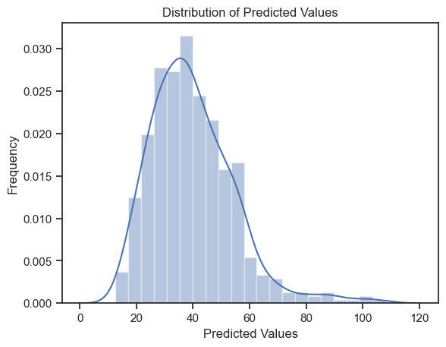
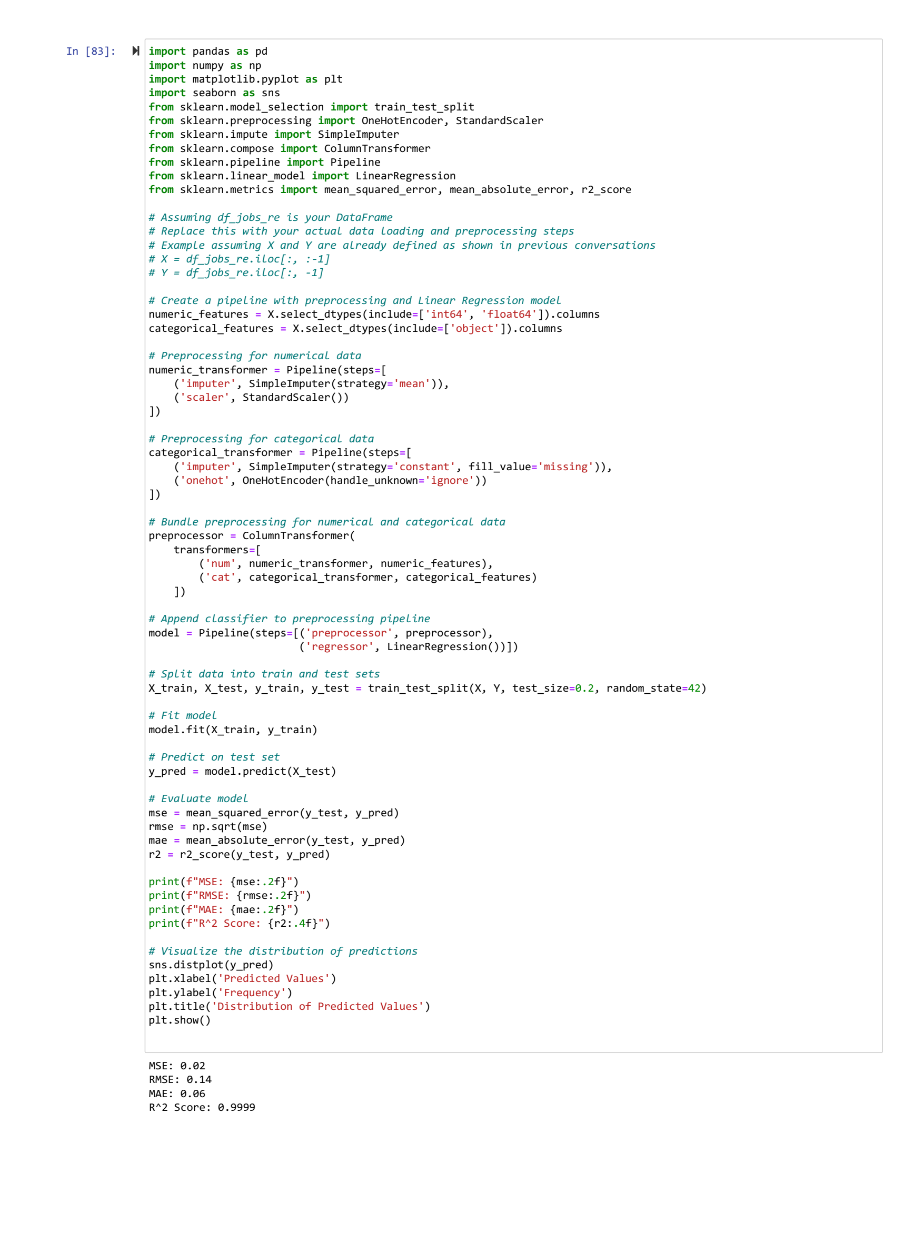

Slide 19
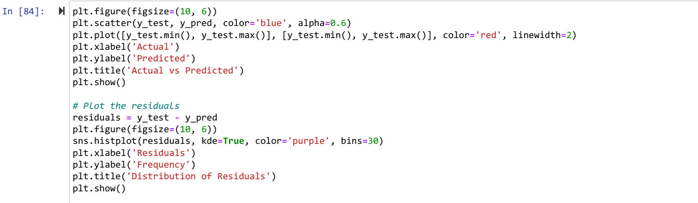
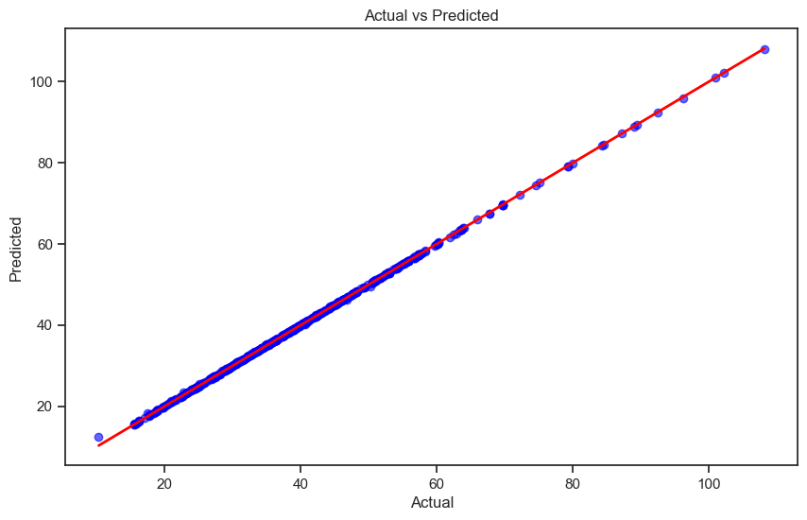
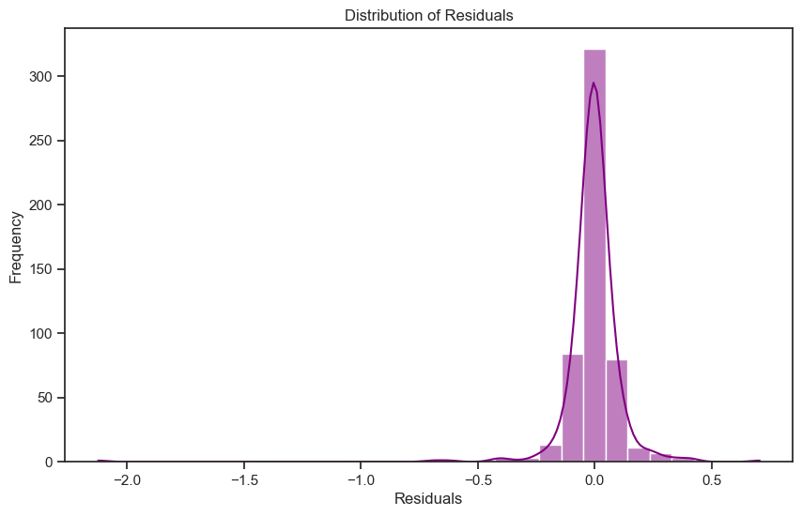

Slide 20
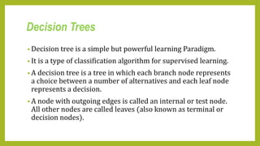
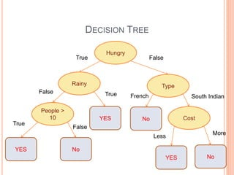

Slide 21
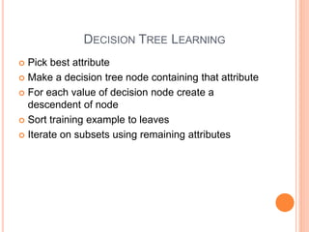
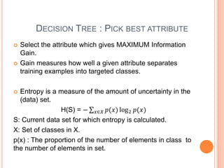

Slide 22
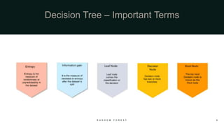

Slide 23
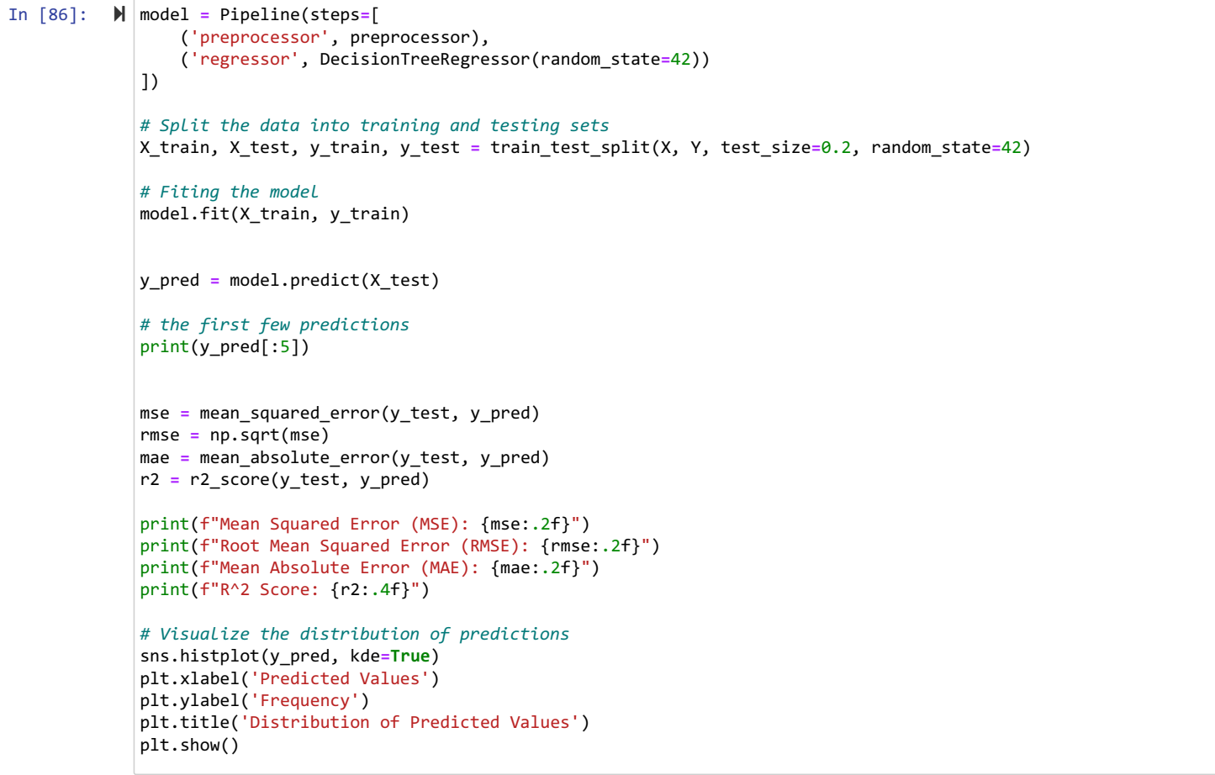
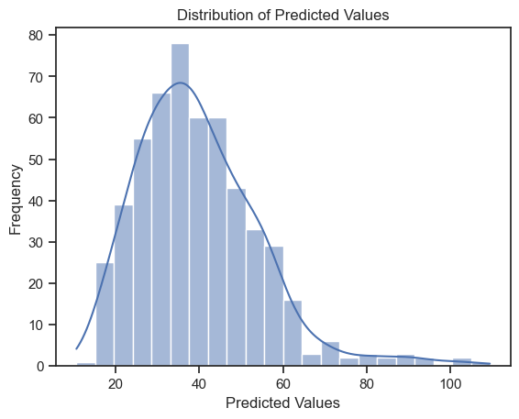
[29.55817308 34.61538462 90.14423077 44.15865385 29.03581731] Mean Squared Error (MSE): 0.03 Root Mean Squared Error (RMSE): 0.17 Mean Absolute Error (MAE): 0.04 R^2 Score: 0.9999

Slide 24
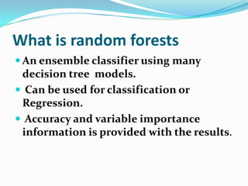

Slide 25
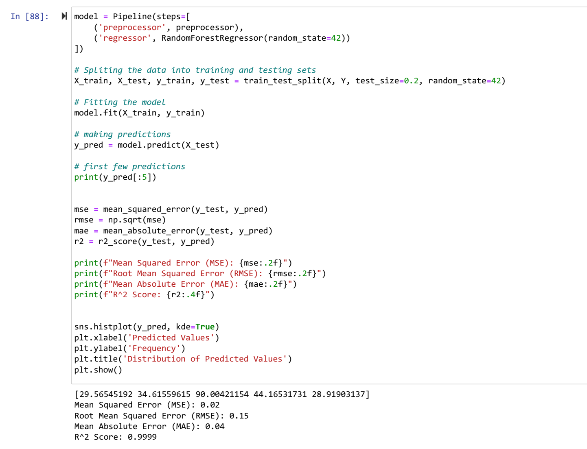
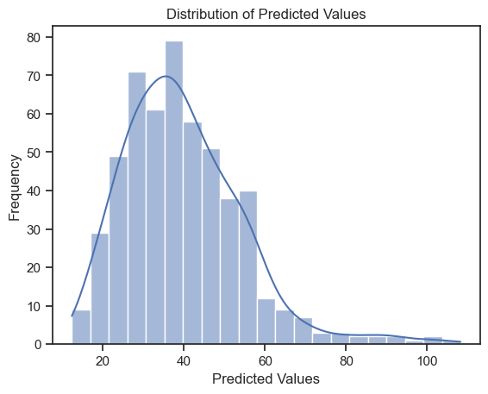

Slide 26

Here's a comparison of the three regression algorithms (Linear Regression, Decision Tree, and Random Forest) based on the metric: | Metric | Linear Regression | Decision Tree | Random Forest | |-------------------------|-------------------|---------------|---------------| | Mean Squared Error (MSE)| 0.02 | 0.03 | 0.02 | | Root Mean Squared Error (RMSE) | 0.14 | 0.17 | 0.14 | | Mean Absolute Error (MAE)| 0.06 | 0.04 | 0.04 | | R² Score | 0.9999 | 0.9999 | 0.9999 | ### Comparison and Analysis: 1. Mean Squared Error (MSE): - Linear Regression and Random Forest have the lowest MSE (0.02), indicating that on average, the prediction errors are slightly smaller for these models compared to the Decision Tree (0.03). 2. Root Mean Squared Error (RMSE): - Linear Regression*and Random Forest both have lower RMSE (0.14) compared to the Decision Tree (0.17). RMSE is useful for understanding the magnitude of prediction errors; lower values indicate better performance. 3. Mean Absolute Error (MAE): - Decision Tree and Random Forest both have a lower MAE (0.04) compared to Linear Regression (0.06). MAE provides the average absolute error between predicted and actual values, and lower values indicate better accuracy. 4. R² Score*: - All three models have an R² Score of 0.9999, suggesting that they all explain almost all the variability in the response variable, indicating excellent fit to the data. Conclusion: - Random Forest appears to be the best model overall. It has the lowest or equally low MSE and RMSE, and the MAE is tied with the Decision Tree for the lowest value. Additionally, it maintains a perfect R² score. - Linear Regression also performs very well, with comparable MSE and RMSE to the Random Forest. However, its MAE is slightly higher. - Decision Tree* has a slightly higher MSE and RMSE but matches the Random Forest in MAE and R² score. Given the metrics, the Random Forest model provides a strong combination of low error rates and high explanatory power, making it the best choice among the three for this dataset.
This Photo by Unknown Author is licensed under CC BY-NC-ND

Slide 27
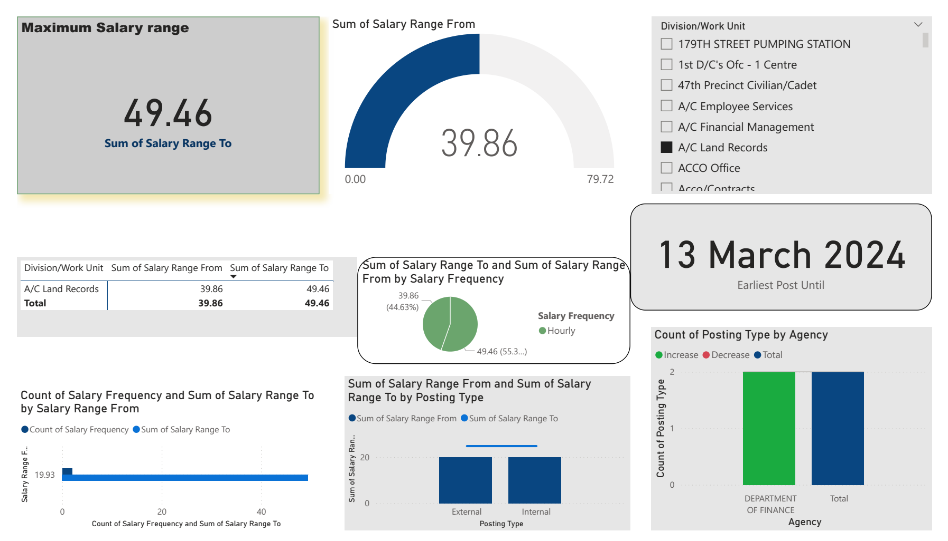
DASHBOARD

Slide 28
Thank You!

